Slide 1
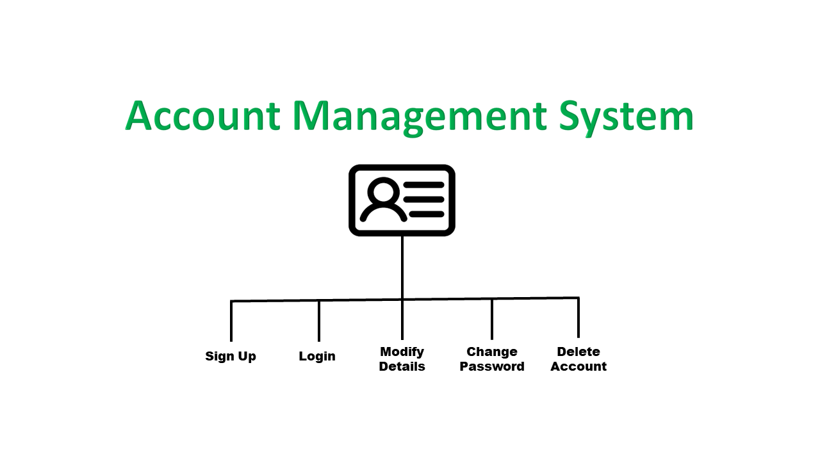
Account Management System
Introduction
Our Account Management System is a secure and user-friendly platform designed to streamline account creation, login, and modification. Users can easily register for an account, access their profiles through a login process, and update their information as needed. The system also provides an efficient way to modify account details with the help of a customer representative, ensuring smooth and hassle-free account management.
(NOTE :- This is a flowchart image showing function prototypes of our system)

Slide 2

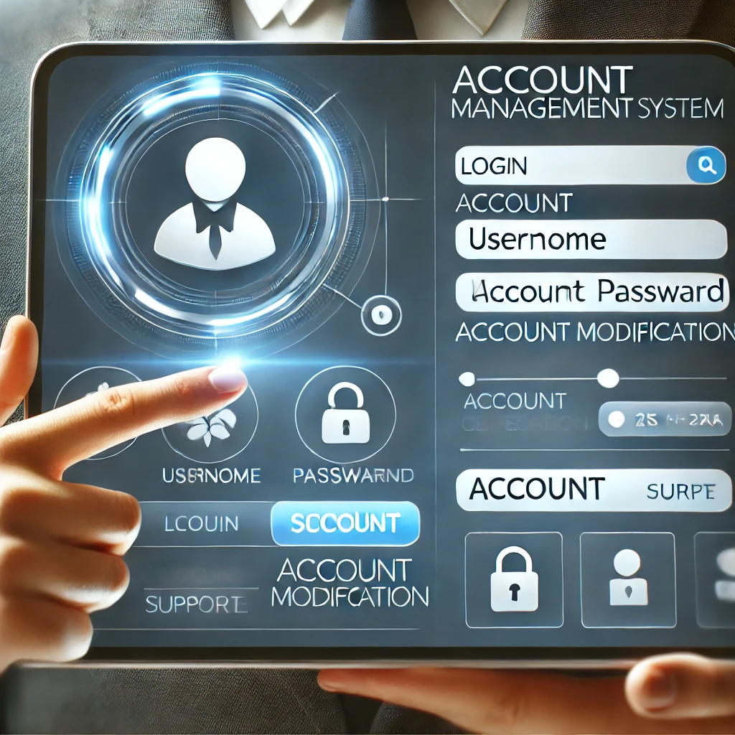
Account Management System
Structures & Libraries Used
In our Account Management System developed using C programming, we have effectively utilized various structures and libraries to achieve a robust and functional application. The system leverages file handling to store and retrieve account data, ensuring persistent data management. We utilized C structures to efficiently organize and access account information. String library functions were employed for handling user input and managing textual data. The project also features user- defined functions to modularize the code and improve readability. Control flow is managed using if-else statements and switch-case constructs, providing a structured approach to decision- making within the system. This combination of techniques and structures ensures a reliable and scalable account management system.

Slide 3

Account Management System
Conclusion
In summary, the account management system created with C programming showcases its efficiency and reliability. With features like account creation, login, and password management, the system meets modern requirements while maintaining a strong focus on security and usability. This project highlights the power of C programming in solving real-world problems and delivering practical solutions.
Hope You Liked And Enjoyed Our Project………

Slide 4



Greetings From
Our Members
Archan Gautam Pranish Bhattarai

